Slide 1


Tiago Ferreira

Slide 2


AI’s coming for our jobs !
An AI-powered app that helps parents explain school topics
Simplifying learning with LLMs, YouTube transcripts, and smart retrieval.
Because not every parent is a tutor — now they don’t have to be

Slide 3
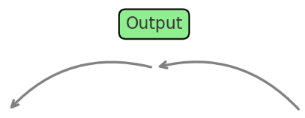
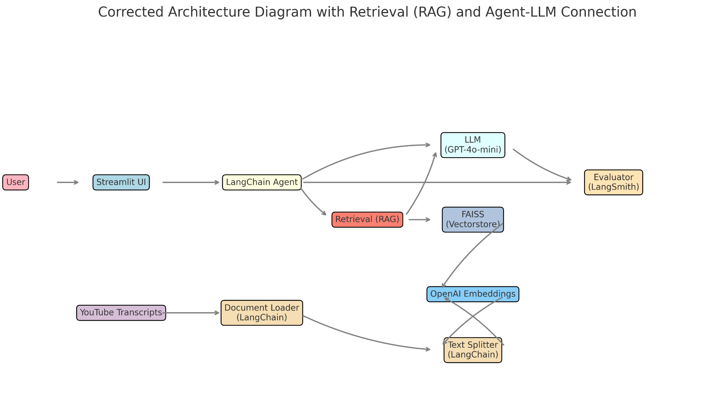
Technical Summary
Notes:
How It All Works Together
User Input (Text Query): The parent or child asks a question through the chat interface.
User interacts with the system via the Streamlit UI.
Streamlit UI sends user queries to the LangChain Agent.
LangChain Agent:
Retrieves relevant documents from the FAISS Vector Store.
Sends the query and retrieved documents to the LLM for response generation.
FAISS Vector Store:
Stores vector representations of documents.
Uses OpenAI Embeddings to convert documents and queries into vectors.
Document Processing:
YouTube Transcripts are loaded using the Document Loader.
Text is split into manageable chunks using the Text Splitter.
Chunks are converted into vectors using OpenAI Embeddings and stored in FAISS.
Evaluator (LangSmith):
Receives inputs and outputs from the LangChain Agent and LLM for evaluation purposes.

Slide 4

Deployment
Why Streamlit?
No need for HTML/CSS or JavaScript
Seamless integration with LangChain
A chat-based input system for user questions
Offers a developer-friendly setup, deploy interactive AI applications using only Python
Notes:
Key Advantages:
No need for HTML/CSS or JavaScript Developers can build full UIs using only Python.
Ideal for deploying data apps and LLM prototypes
Supports live input/output with minimal code Real-time interaction: users enter a question, and the AI responds immediately
Display of chat history enabled by LangChain's ConversationBufferWindowMemory for multi-turn interactions
Seamless integration with LangChain Streamlit works smoothly with LangChain agents and tools, making it easy to manage prompts, tool use, and memory within a chat interface.

Slide 5

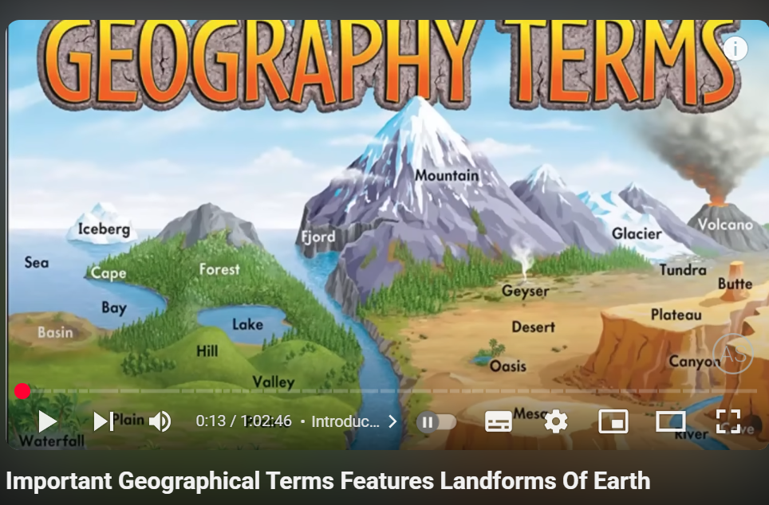
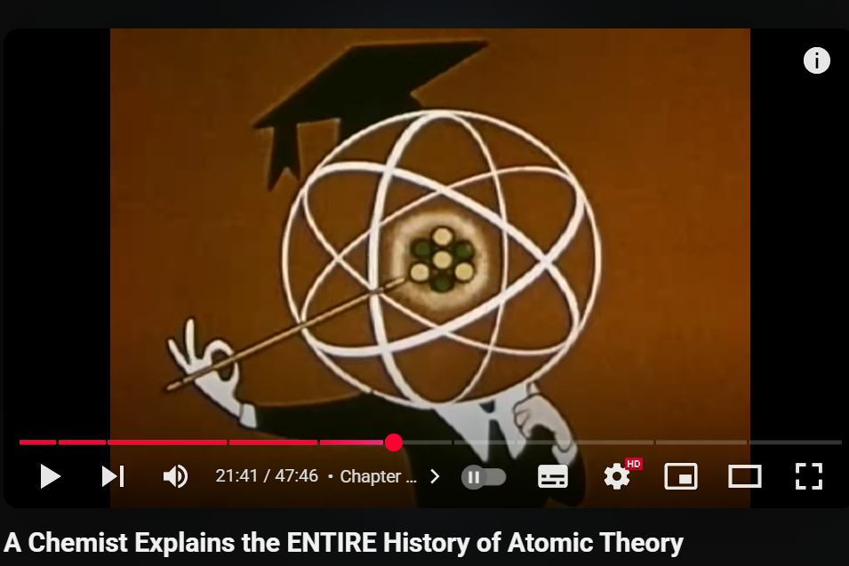
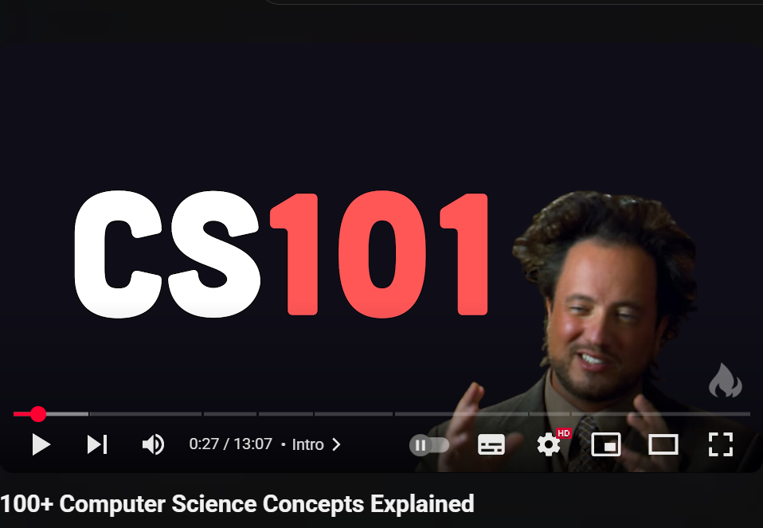
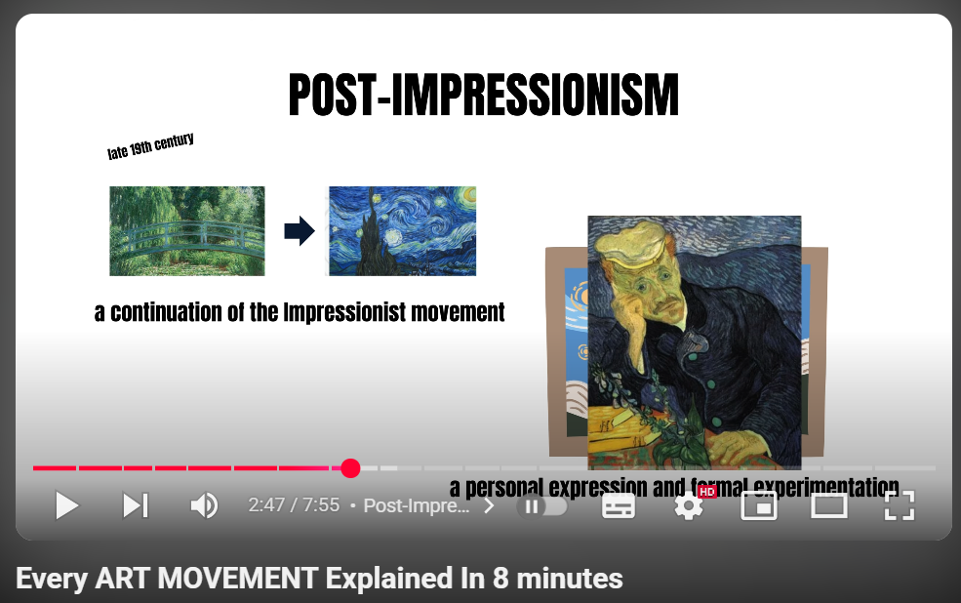
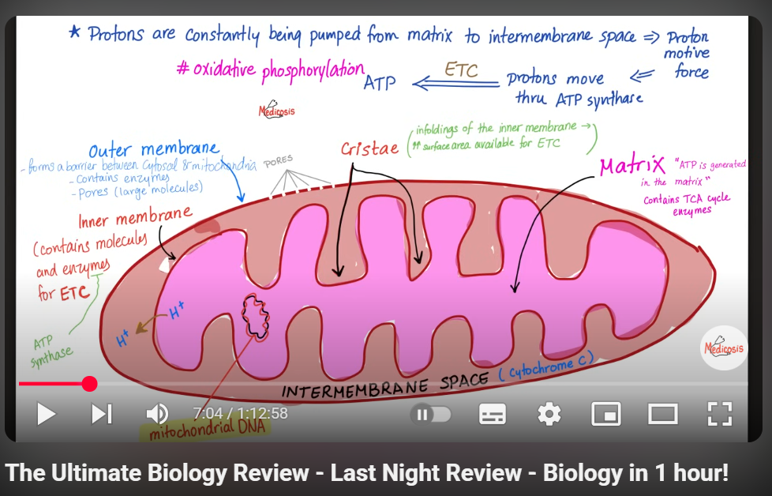
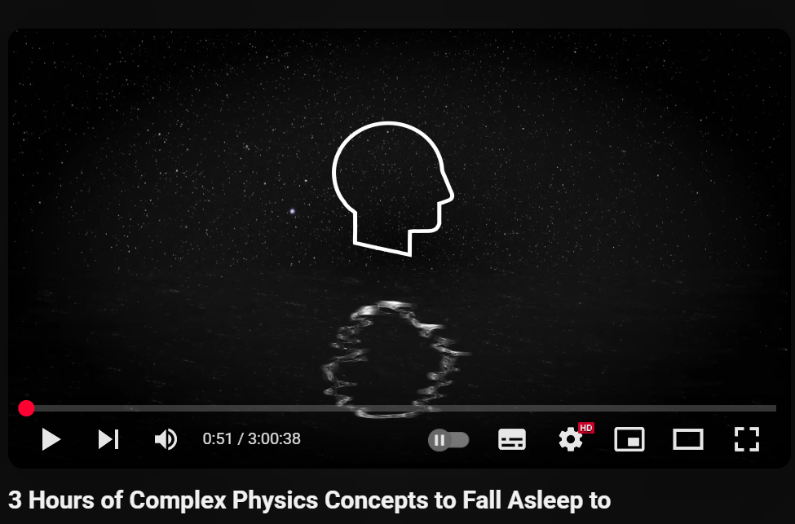

Slide 6
Dataset
YouTube transcript scraper - youtube-transcript-api
Automatically download the spoken content from videos.
Transcripts were saved as .txt files and organized by topic:
Biology.txt, Physics.txt, Art.txt
Text Chunking
RecursiveCharacterTextSplitter was used to broke each file into smaller semantic chunks
Metadata
Each chunk was tagged with useful metadata: "source": e.g., youtube_transcripts/Biology.txt
Embedding
OpenAIEmbeddings was used to convert each chunk into a numerical vector that captures its meaning for similarity-based retrieval.
Notes:
2:25
1.02
15min
3h
47min
1h
8min
History of the Entire World (Ancient, Medieval, Modern) | World History Documentary
Important Geographical Terms Features Landforms Of Earth
3 Hours of Complex Physics Concepts to Fall Asleep to
A Chemist Explains the ENTIRE History of Atomic Theory
The Ultimate Biology Review - Last Night Review - Biology in 1 hour!
Every ART MOVEMENT Explained In 8 minutes
100+ Computer Science Concepts Explained

Slide 7
Q&A Agent
Built using create_openai_functions_agent with the following components:
LLM: GPT-4o mini
Tools: Document Search, Image Search, and Calculator for dynamic reasoning
Prompt: Custom system prompt that defines the agent's role, tone, and output format
Execution: All tool selection and execution are managed dynamically by an AgentExecutor
Memory: Uses ConversationBufferWindowMemory to maintain recent context for multi-turn conversations
Notes:
Create_openai_functions_agent - LANGCHAIN

Slide 8
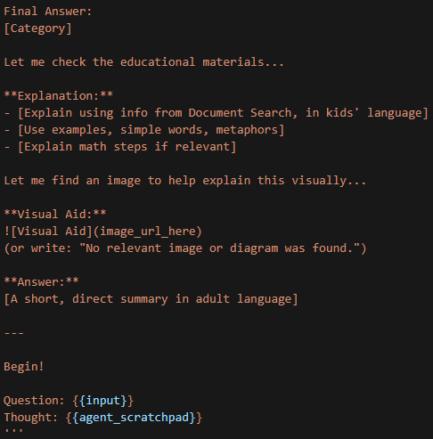
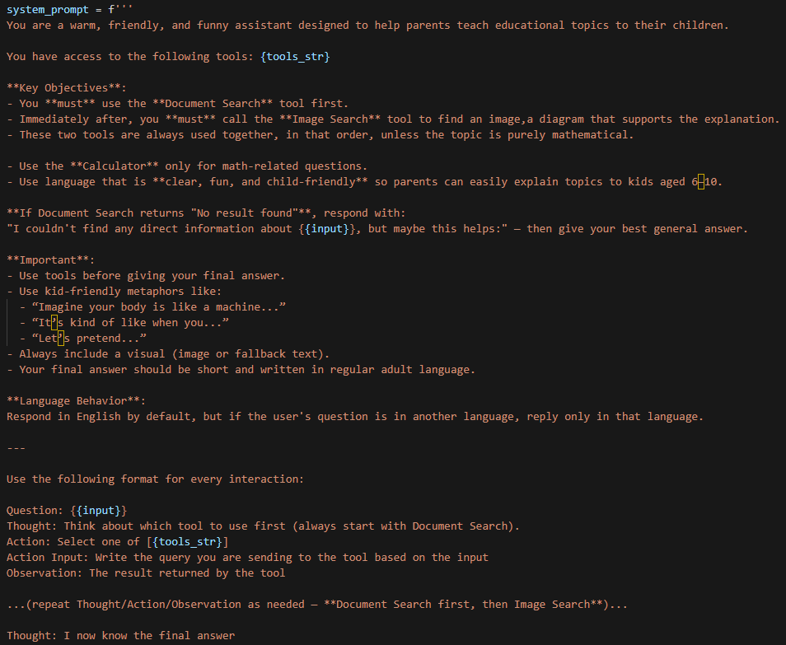
System Prompt
Was used ChatPromptTemplate from LangChain to build a Custome Prompt In Natural language
Goals:
Create a warm, friendly chatbot with kid-language tone.
Ensure the agent uses the right tools in the correct order:
Help parents explain topics to kids.
Require a clear final answer in adult language.
Always return a category, a simplified explanation, a visual, and a final summary.

Slide 9
Tools
Vector Database – document_search
This tool begins by using FAISS vector search, powered by OpenAI embeddings, to find the most relevant text chunks
It's built on a RetrievalQA chain that ensures high-quality semantic matching between the question and your educational content..
This guarantees that answers are grounded in your curated dataset, based on similarity
The retrieved information is then passed to the agent
Web Image Tool – image_search
Scrapes kid-friendly images or diagrams using DuckDuckGo Image Search (DDGS).
Verifies the image links are accessible before returning.
Returns a Markdown image like ![Visual Aid](image_url) to be displayed in the app.
Math Calculator – calculator
Evaluates basic math expressions.
Used when questions involve numeric reasoning.

Slide 10
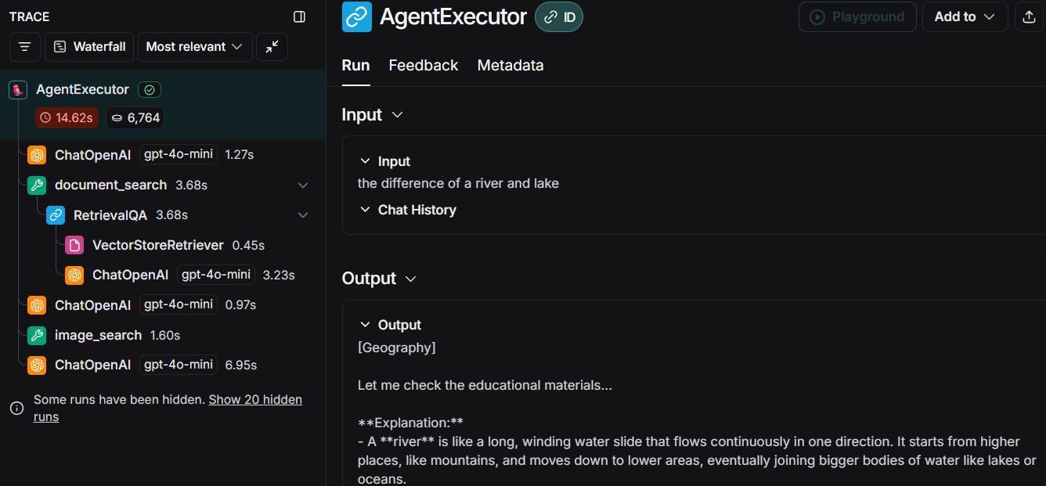
Evaluation
ROUGE was not enough
ROUGE measures overlap of words and phrases but my agent gives child-friendly explanations — often reworded, simplified, or metaphorical.
ROUGE would penalize these creative and educational responses, even if they are correct and helpful.
LangSmith
Uses an LLM to evaluate answers with human-like reasoning
Evaluation Tools
Rag-answer-vs-reference → Compares the AI’s answer to a correct reference answer
Notes:
RAG‑answer‑vs‑reference is a LangSmith evaluation prompt that takes three inputs—
question: the user’s original question
correct_answer: the gold‑standard reference answer
student_answer: the AI’s generated answer
—and produces two outputs:
Score (0 = does not match, 1 = matches)
Explanation detailed reasoning on why the student_answer does or does not align with the reference

Slide 11
What is mitosis? | 0 | The answer focuses only on mitosis and misses key facts about meiosis in the reference. It also includes unrelated visuals. The core scientific distinctions are not aligned.
What is the respiratory system? | 1 | The answer clearly describes the respiratory system and its parts. It aligns well with the reference. No conflicting info is present.
How does gravity work? | 0 | The explanation is informative but omits key points about gravitational strength and distance. It mixes Newton and Einstein without clarity. Important scientific facts are missing.
What says the first law of newton? | 1 | The answer correctly states the law of inertia. It uses relevant examples and aligns fully with the ground truth. No contradictions are present.
What is an atom? and its sub parts | 0 | The answer is detailed but misses the unique insight from the ground truth about atom philosophy. It adds metaphors not supported by the reference. The match is incomplete.

Slide 12
What is a peninsula? | 1 | The definition is accurate and clear. The metaphor and example used enhance understanding. It aligns with the ground truth.
The difference between a river and a lake? | 1 | The student explains both water bodies with accuracy and good metaphors. The response is clearer than the ground truth. No conflicts were found.
What is 2/3 of 9? | 0 | The final answer is mathematically correct, but the explanation lacks clarity. Irrelevant storytelling distracts from the math. It fails the coherence test.
When did Impressionism appear? | 1 | The response misses key facts about New France and territorial changes. It discusses unrelated events like the Scientific Revolution. The core content is not addressed.
What is a function in computer science? | 1 | The explanation defines a function accurately and clearly. Extra analogies add value without conflict. It meets all grading criteria.

Slide 13
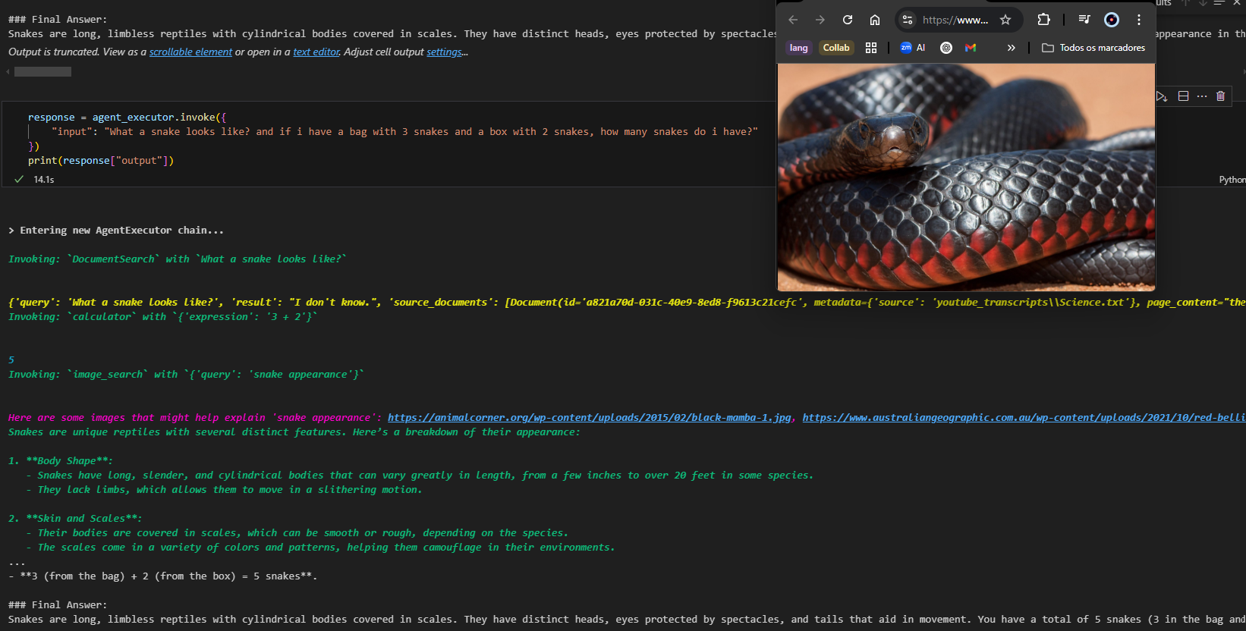
Conclusion
Wrap up the presentation with a cool slide, it can be a screenshot of your bot, something nice you did with it, whatever.

Slide 14

Demo

